Slide 1

SWE-690 CAPSTONE PROJECT- FALL-2015
SOFTWARE REQUIREMENT SPECIFICATION AND
HIGH LEVEL ARCHITECTURE DOCUMENT
EMPOWER STUDENTS SKILLS BY SERVICES
(ES³)
Guided By:
Professor: Hann So
Submitted By:
Desam Syama Sundara Reddy (#86287)
Vijay Krishna Vemuri (#87799)
Dabeeth Nagam (#87873)
Naga Sankara Manoj Hota (#87750)

Slide 2
Table of Contents
INTRODUCTION.......................................................................................................... 3
PURPOSE............................................................................................................................5
SCOPE................................................................................................................................ 6
TOOLS AND TECHOLOGIES TO BE USED ........................................................... 7
VERSION CONTROL SYSTEM................................................................................... 9
PROJECT ARCHITECTURE......................................................................................... 10
SOFTWARE INTERFACE............................................................................................. 12
COMMUNICATION INTERFACE/CONSTRAIN................................................. 13
ER DIAGRAM................................................................................................................. 14
. USECASE MODEL SURVEY.........................................................................................15
DATABASE DESIGN......................................................................................................16
USECASE REPORTS......................................................................................................17
ACTIVITY DIAGRAMS..................................................................................................22
SEQUENCE DIAGRAM.................................................................................................23
REFERENCES ................................................................................................................. 27

Slide 3
INTRODUCTION
Methodology
RUP (Rational Unified Process)
This project would practice Rational Unified Process (RUP), which is a software engineering process that provides disciplined approach towards project implementation. RUP provides guidelines for successful implementation of a project like Iterative Development which helps the software requirement specification (SRS) to evolve throughout the development cycle

Slide 4
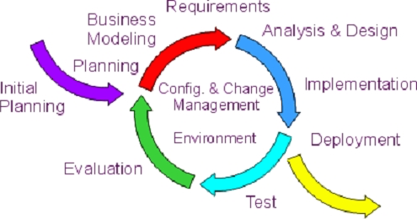
The RUP process consists of the following four consecutive phases for a development life cycle:-
(a) Inception
(b) Elaboration
(c) Construction
(d)Transition

Slide 5
PURPOSE
‘Empower Students skills by Services’ (ES³) is an online web application to provide a platform for students who wants to improve skills by delivering free lectures for enthusiastic enrolled learners. The purpose of this project is to help people who lack resources but want to learn advanced technical and communication skills. As one of the oldest English proverb which says ‘Give a man a fish and you feed him for a day. Teach a man to fish and you feed him for a lifetime’, this application helps people to enroll for classes which are taught by the students of ITU.

Slide 6
SCOPE
There are three basic users in this project Admin, Student, User.
All the users have their own customized web page.
User can search for the required course he/she willing to learn and see the student who teaches it.
Based up on the convenient time they can set up a meeting and exchange their knowledge.
Admin can monitor all the activities going on, he/she has the permission to authenticate the user and student.
Admin has the permission to add/remove courses.

Slide 7
TOOLS AND TECHNOLOGIES TO BEUSED
The application ‘Empower Students skills by Services’ (ES³) is a dynamic web application and is being planned to build with spring MVC (Model, View and Controller), database persistency, with Hibernate Object Relational Mapping (ORM) tool and with RESTFUL Web services. ‘Oracle Web logic’ will be application server to host the application. Junit unit test, TestNG and Selenium Automation testing along with manual testing is required for complete testing of the product. The following complete list of technologies are required to make the application into production:-

Slide 8
Frontend (User Interface).
(a) HTML/JSP
(b) Java Script
(c) CSS
Backend (Server Side Programming).
(a) Java 1.7
(b) Spring MVC
(c) Hibernate- Object Relation Mapping
(d) RESTFUL-web services
Testing
(a) Junit
(b) Test NG
(c) Selenium Auto Testing
Database
Oracle 11g R2
Application Server
Oracle WebLogic

Slide 9
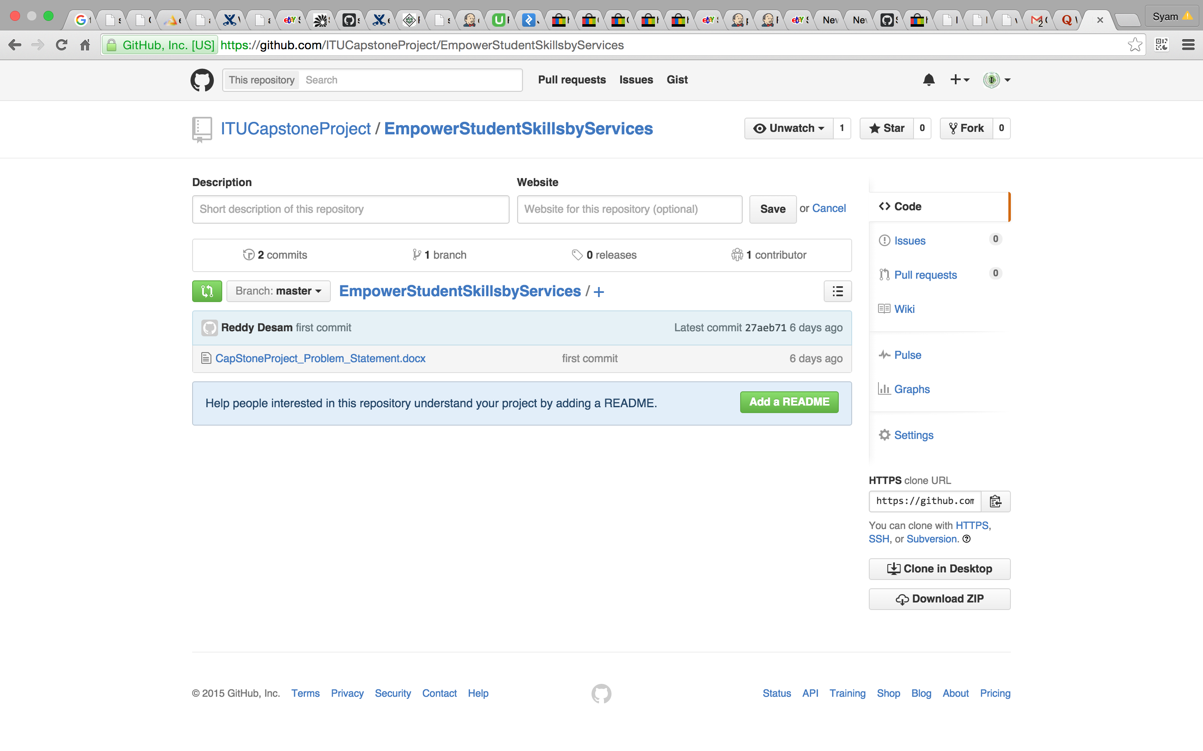
VERSION CONTROL SYSTEM
Version Control is a System that records changes to a file/source code over time so that any version of file/source code can be recalled. Software source code is being version controlled by ‘git’. The following git repository has been created:-
https://github.com/ITUCapstoneProject/EmpowerStudentSkillsbyServices

Slide 10
Project Architecture (Spring MVC Architecture). The user request (JSP or Html pages) is handled by central servlet is called ‘Dispatcher servlet’ and it is further dispatches to controller where the beans are created and process to Business Layer of BO and DAO where java based ORM tool ie Hibernate that provides framework for mapping application domain objects to the relational database tables and vice versa. Further, the communication for web services’ is through over HTTP protocol and here also the databases is mapped with Hibernate framework for backend persistency.

Slide 11
VO
Spring Controller
Dispatcher Servlet
BO
DAO(Hibernate)
RESTFUL Web services
Hibernate
JSP
db
Hibernate
db

Slide 12
Software Interface:
Client on Internet:
Web Browser, operating system
Client on Intranet:
Web browser, operating system
Web server:
WASCE, operating system
Database server:
DB2, operating system
Development End:
Eclipse Luna (Java, J2EE, java Bean, servlets, HTML5, XML, AJAX), DB2, OS (Windows), Web Logic (Web server)

Slide 13
Communication Interface:
Student on Internet will be using HTTP/HTTPS protocols only.
User on Internet will be using HTTP/HTTPS protocol.
Admin on the Internet will be using HTTP/HTTPS protocol.
Constraints:
GUI is limited to English language only.
Login and password is necessary for all the users, students and the admin.
Only ITU registered students and users can avail this service.
This system is limited to single server.

Slide 14
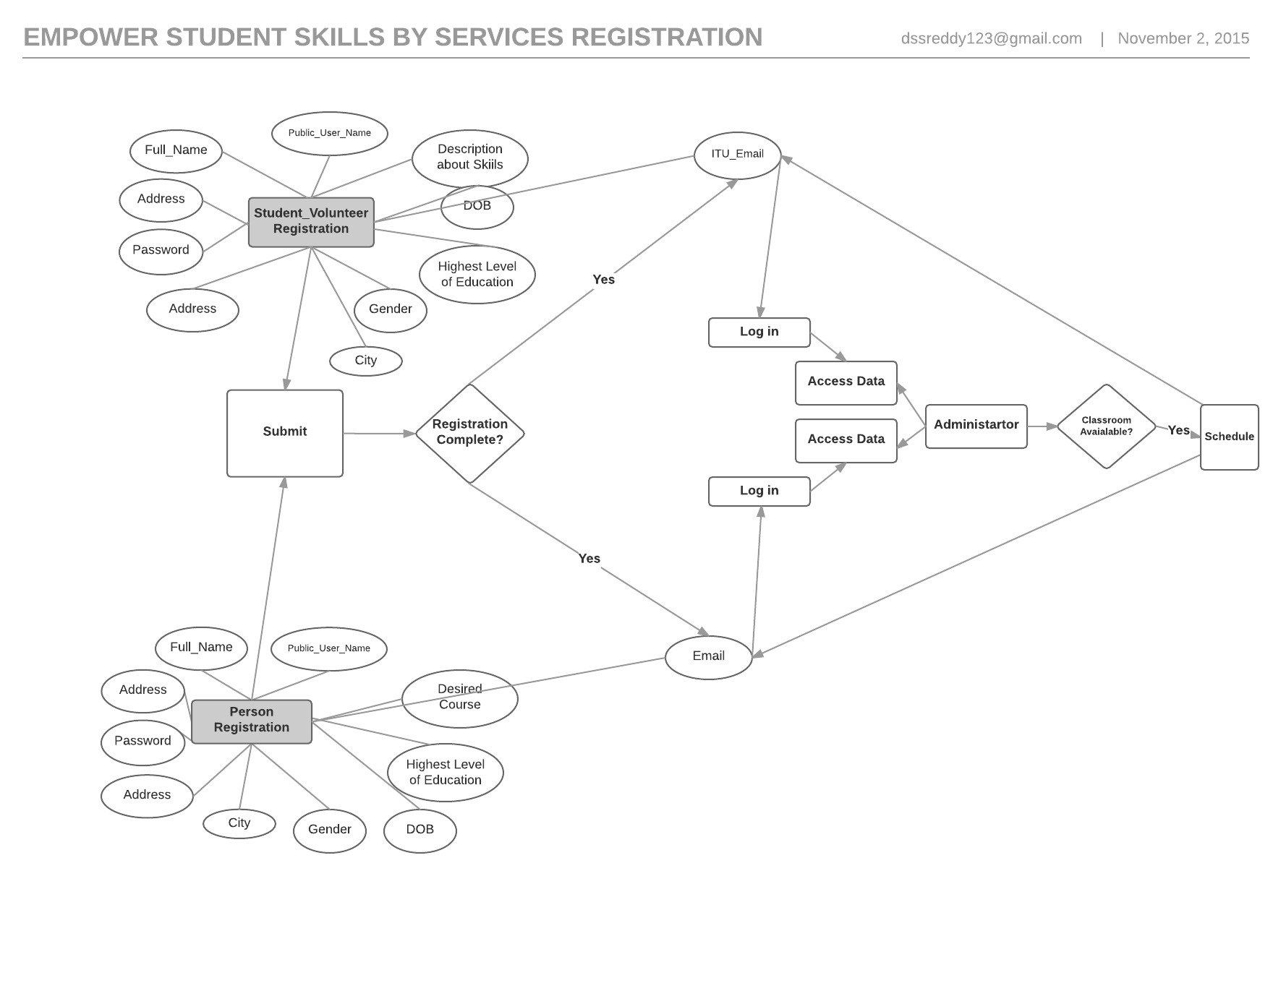
ER Diagram

Slide 15
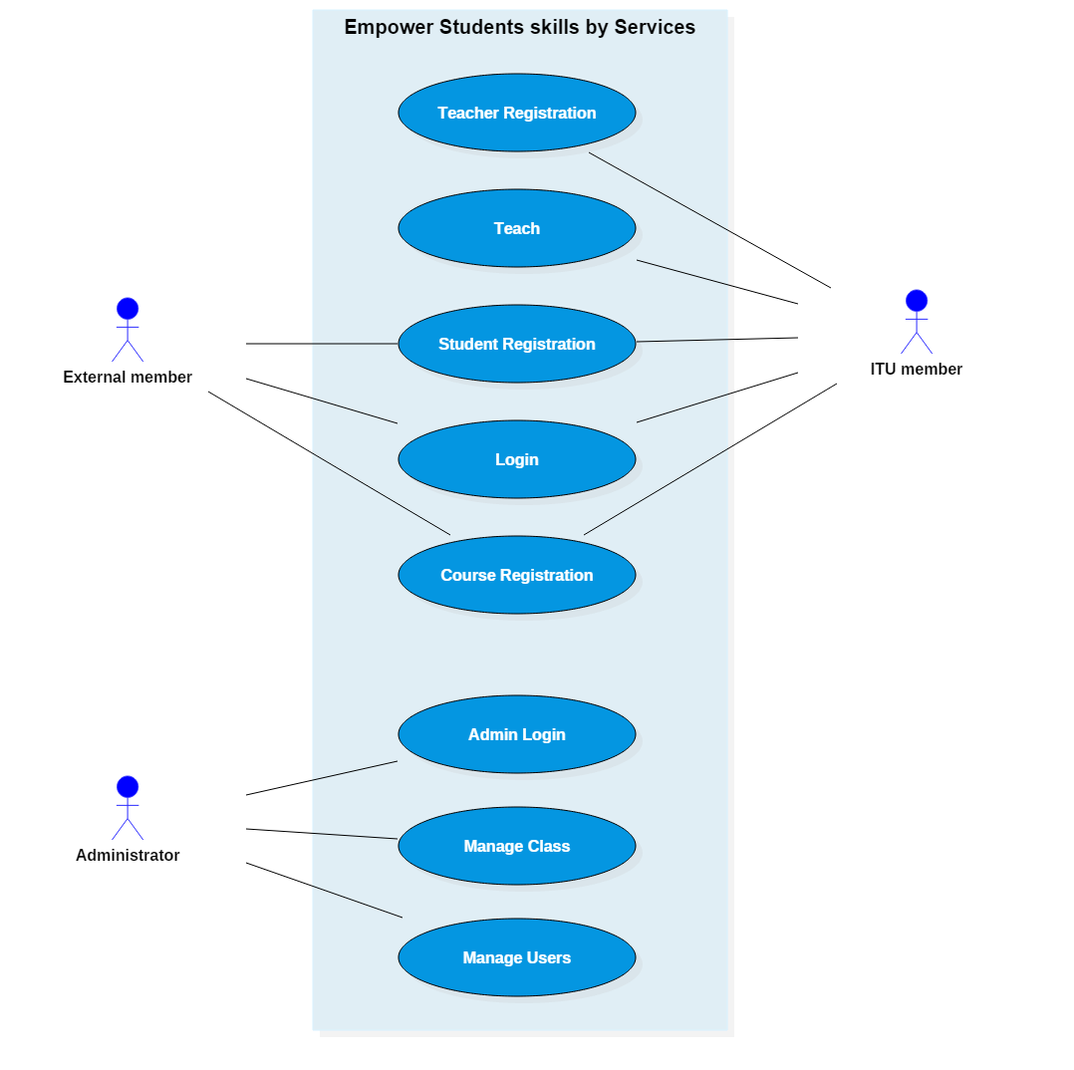
Use Case Model Survey
Student:
Students can fill registration form for skills sets and can propose for course teaching. Students can view the learners who are all registered course and approved by admin.
Course Learners.
Course Learners can search for all courses and can register for their desired course.
Admin.
Admin can view all profiles of students and course learners. Admin can co-ordinate the courses and will inform to course learners and students. Subsequently, admin will arrange classroom for conducting class.

Slide 16
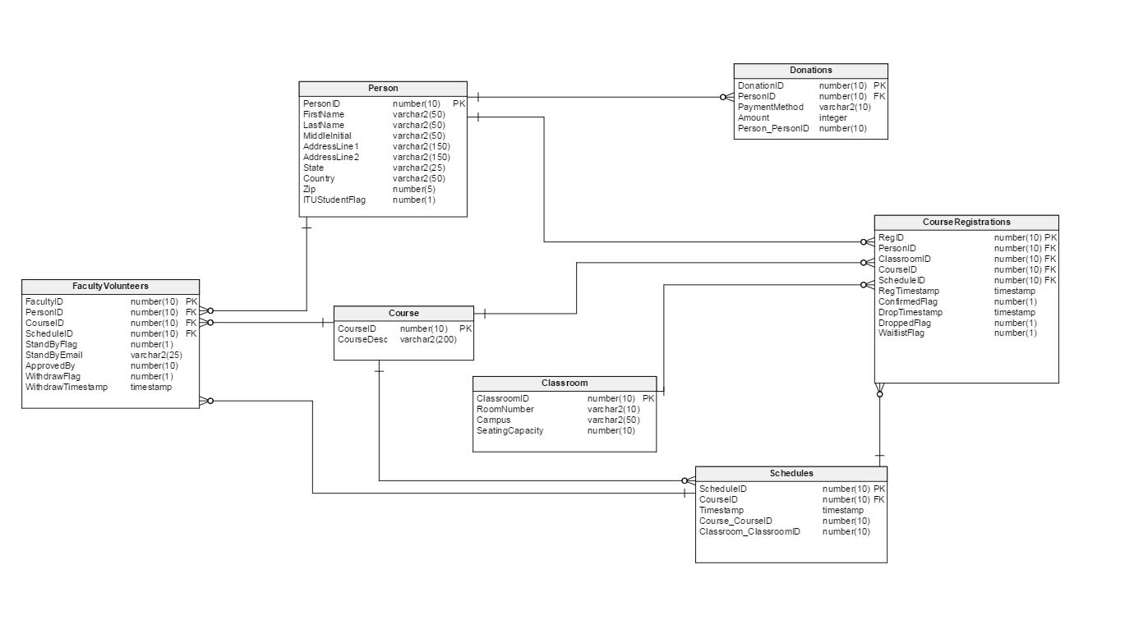
Database Design

Slide 17
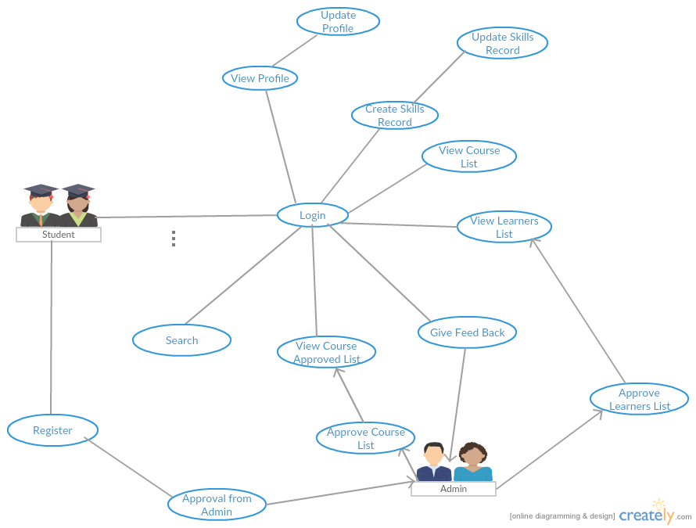
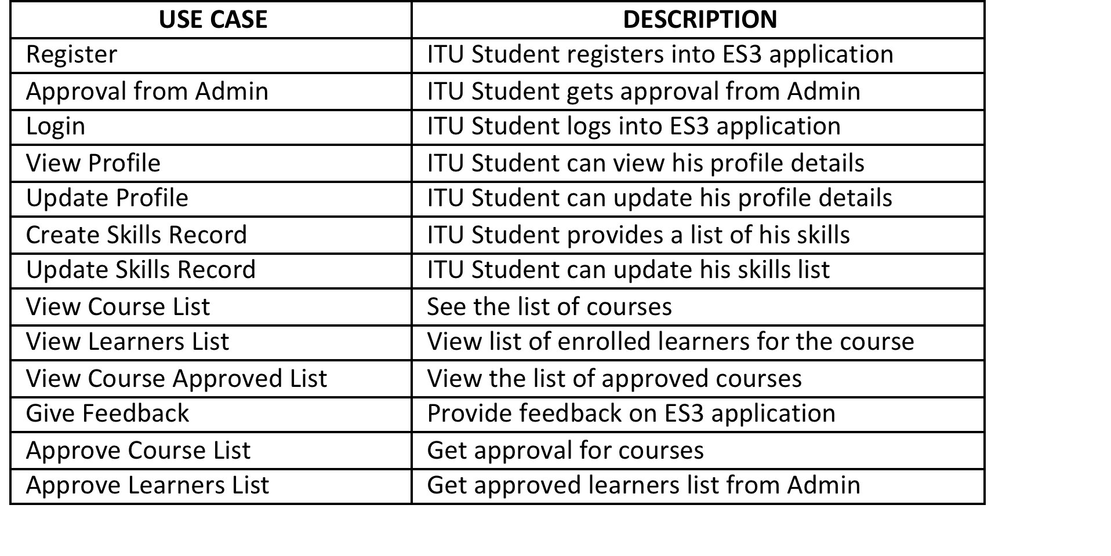
Use Case Reports
Student Use Case Report

Slide 18
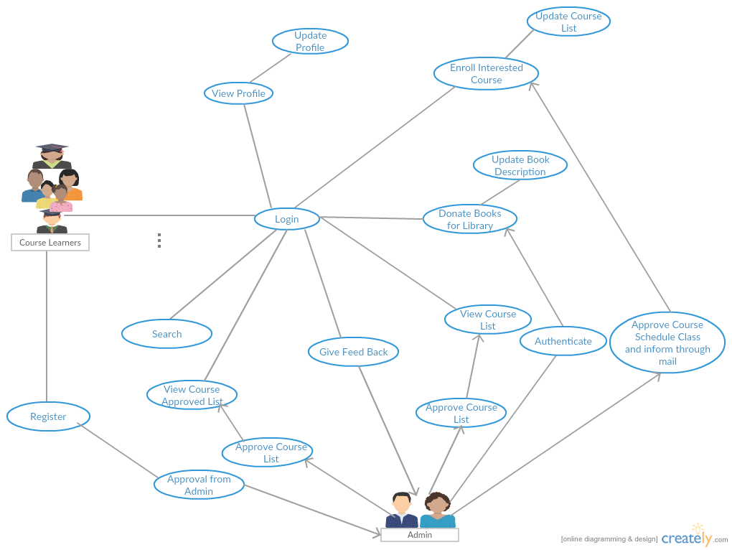
Learners Use Case Report

Slide 19
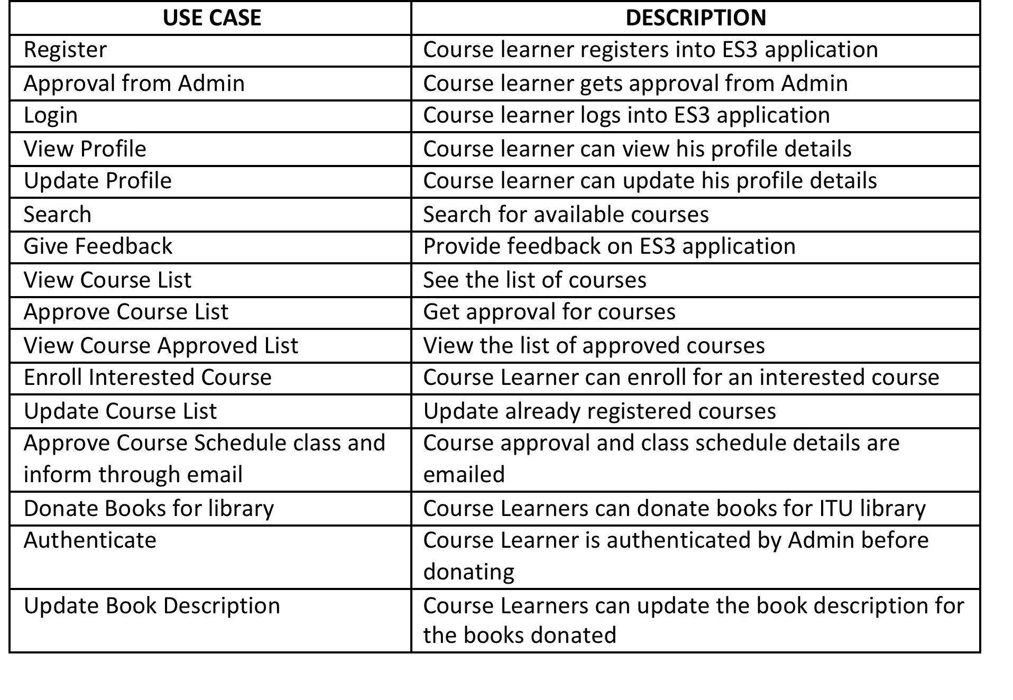

Slide 20
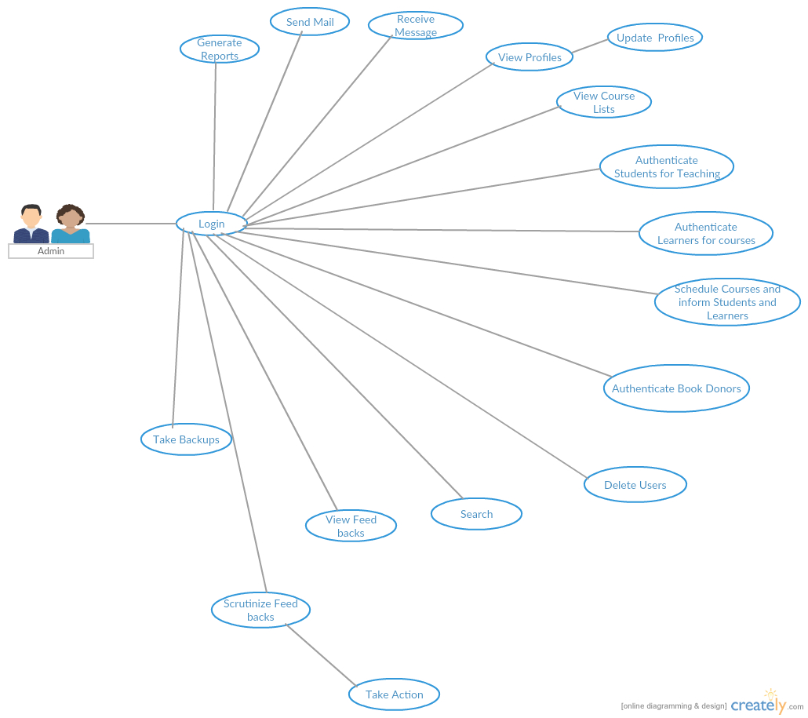
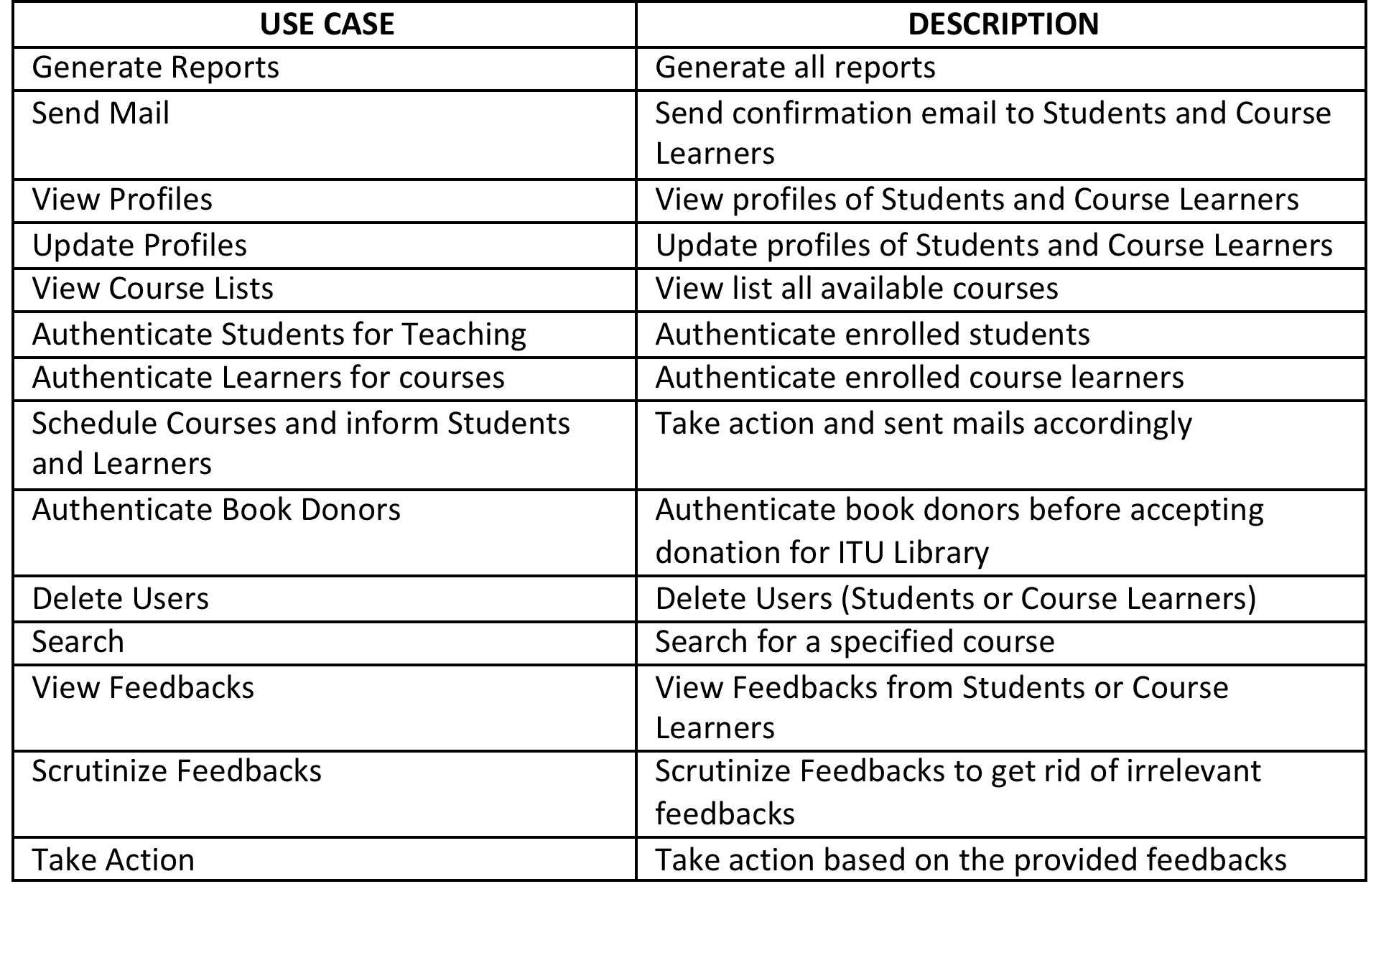
Admin Use Case Rep

Slide 21
User Registration Activity
Initially User is required to fill all mandatory fields in Registration Form. Once Students/Course learners. When the users click submit button, the user name is verified. If the username is already exists, and then the user is again need to fill with new one. If the username validation is passed then password will be checked and finally check for all mandatory fields are filled or not. If the mandatory fields are left blank and filled in correct then the user will be informed to enter the correct values. Once all these verifications are succeeded, then the registration is process is completed.

Slide 22
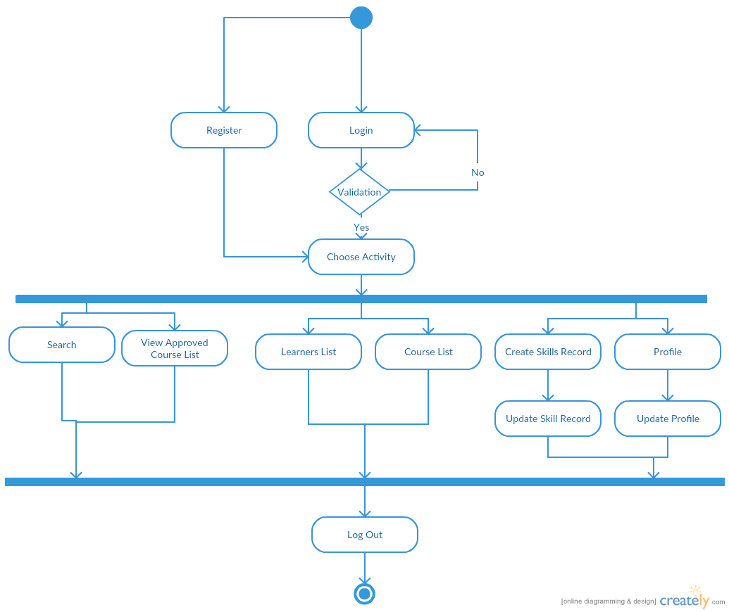
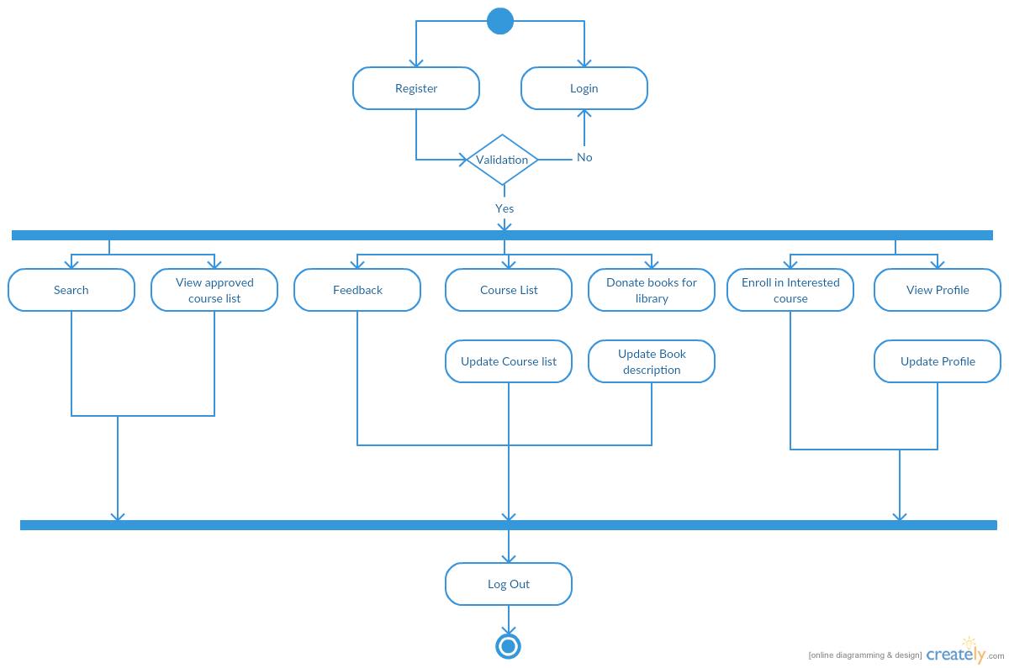
Student Registration Activity
Course Learners Registration Activity

Slide 23
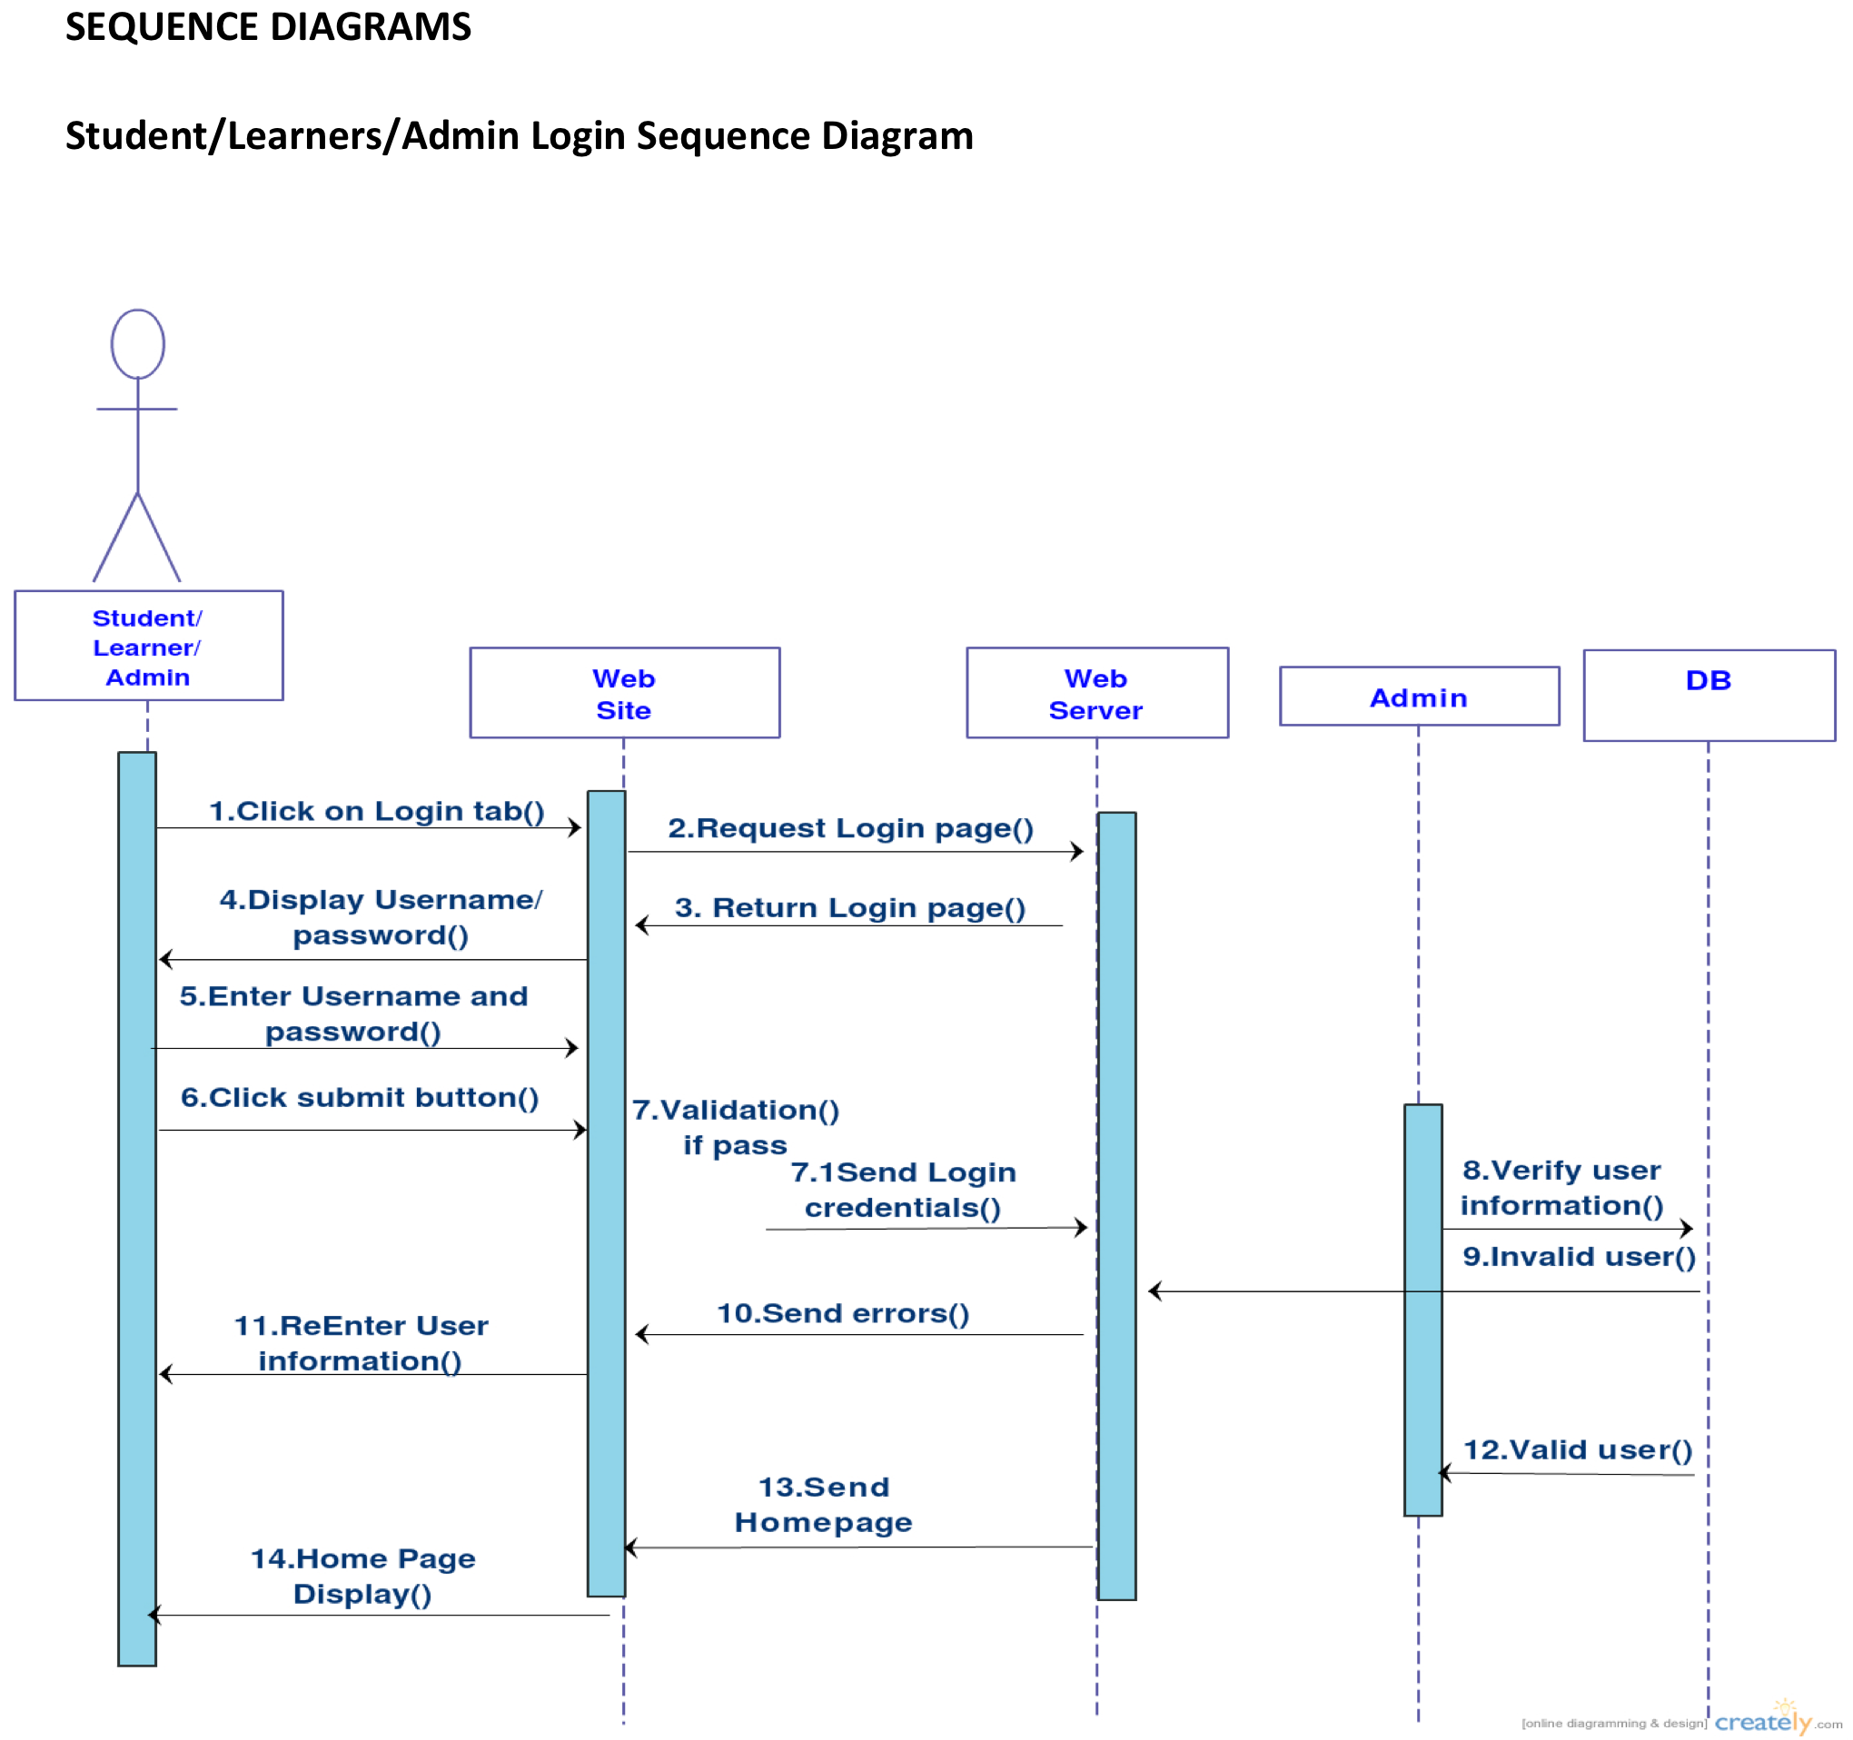

Slide 24
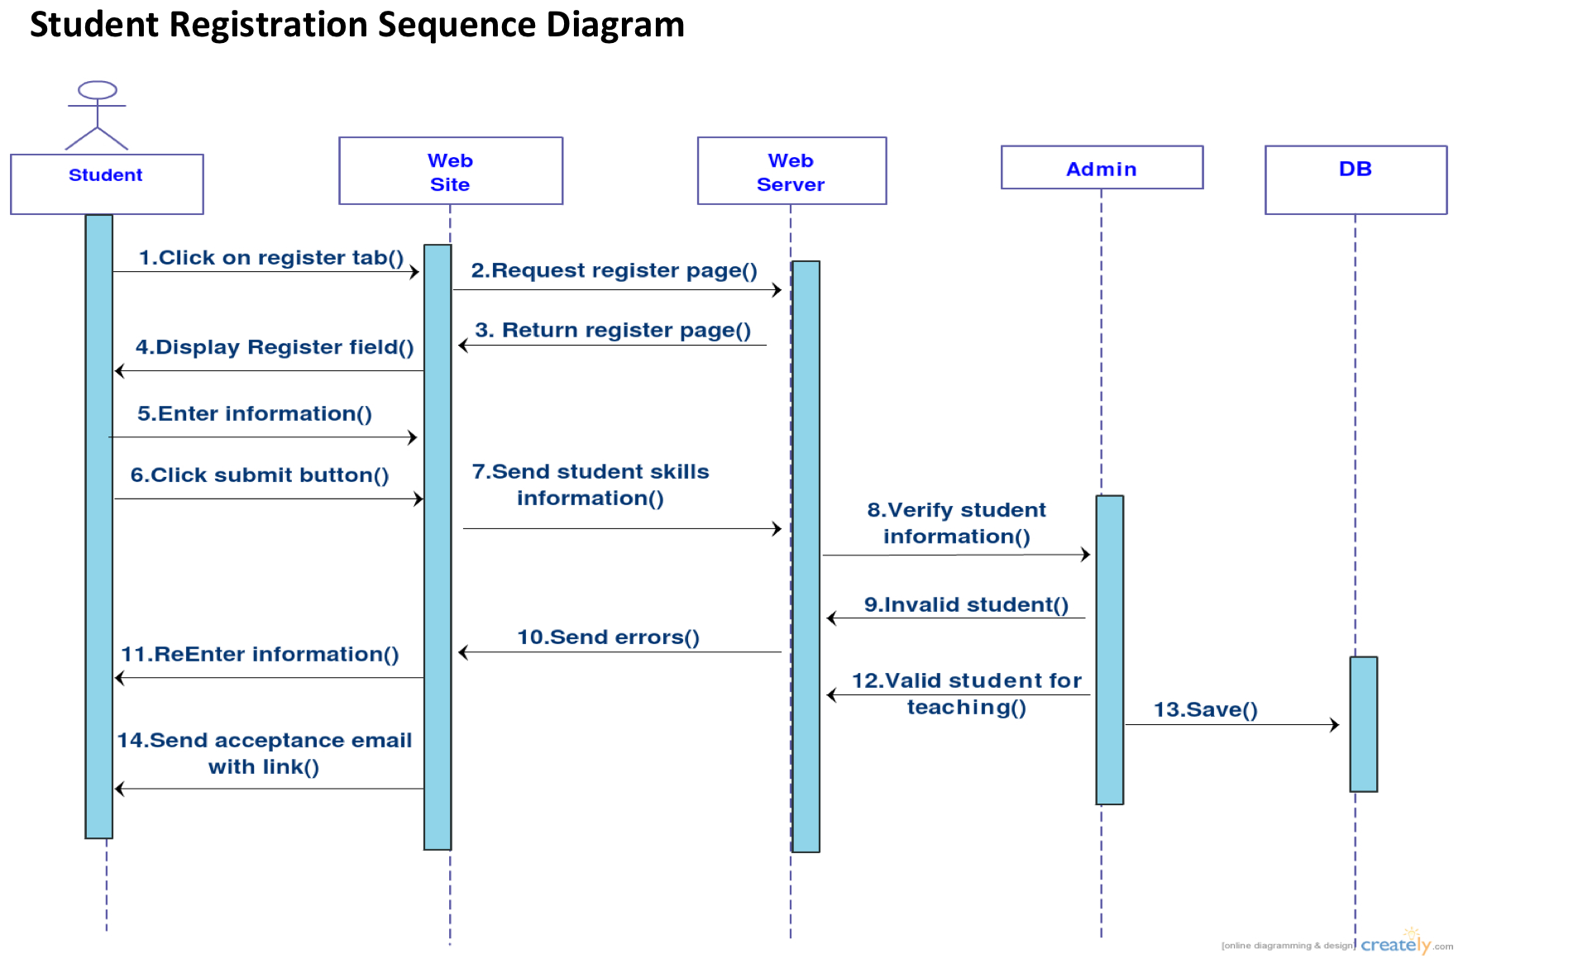
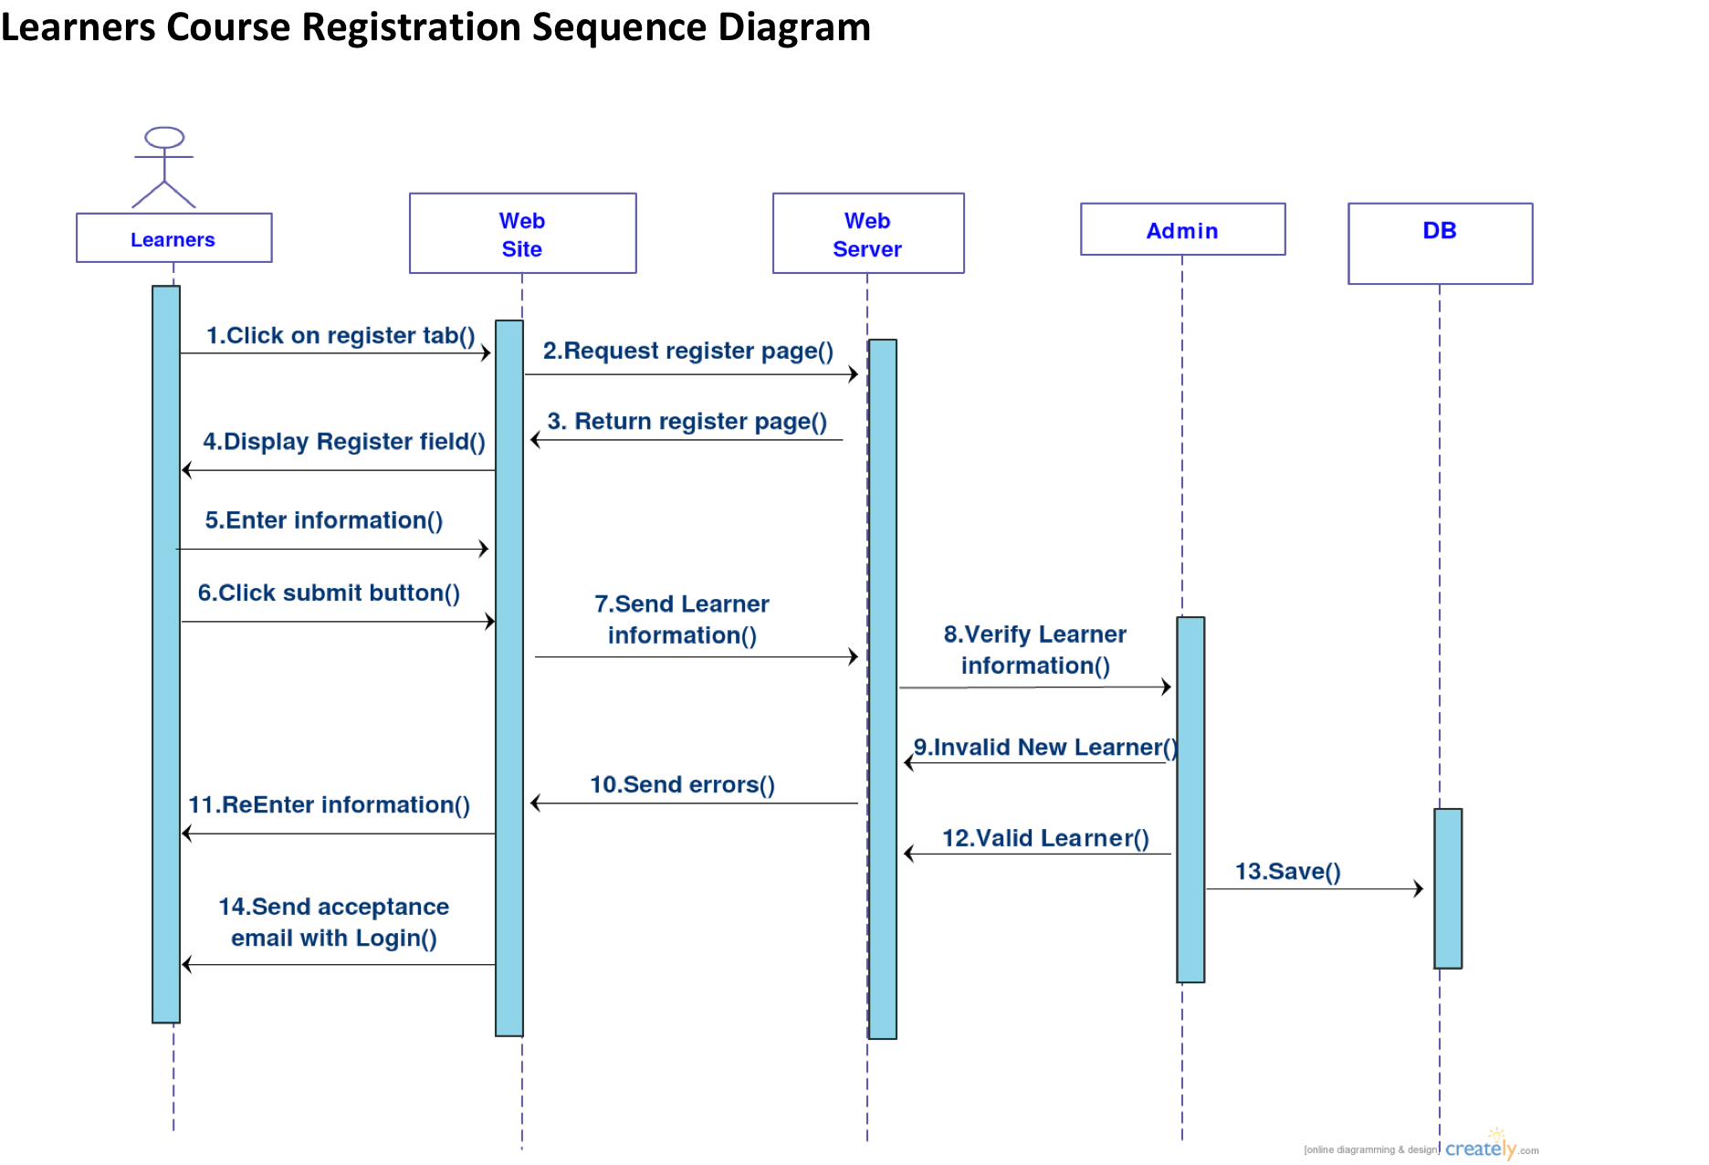

Slide 25
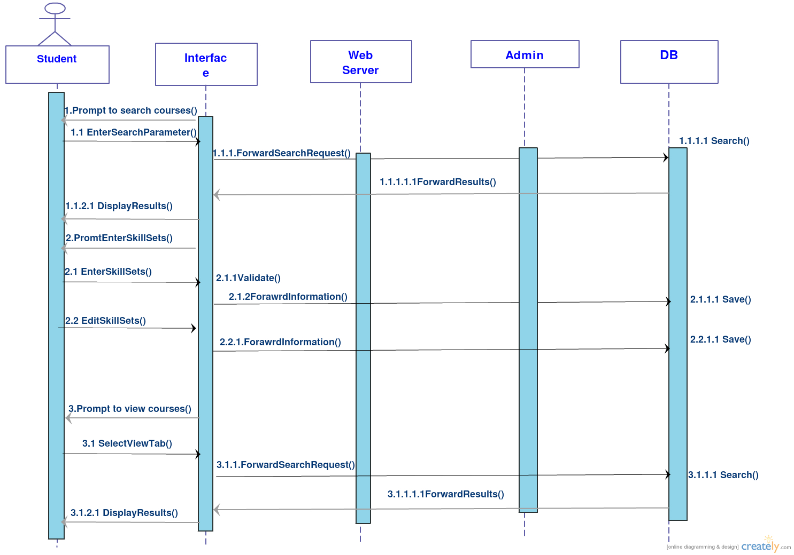
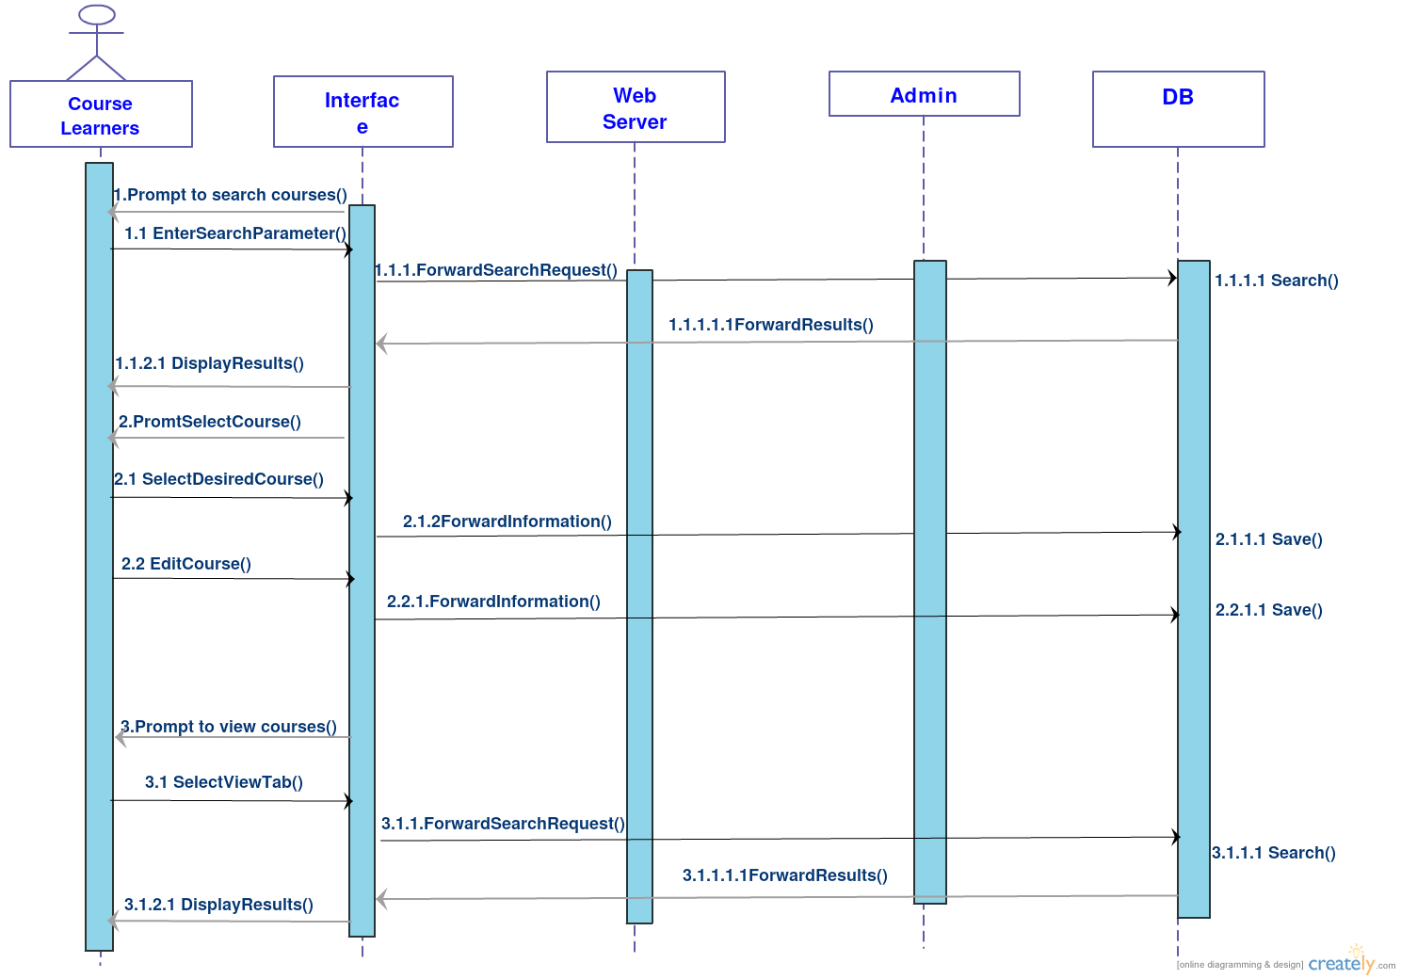
Student Search and Enter Skill Sets Sequence Diagram
Learners Search and Course Registration Diagram

Slide 26
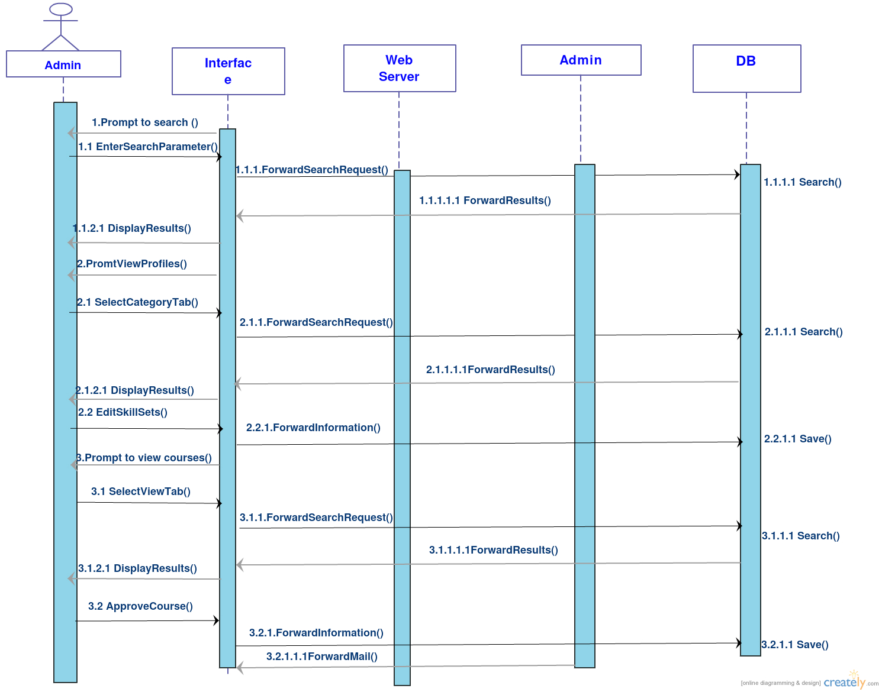
Admin Registration Diagram

Slide 27
References
http://creately.com/
https://github.com/
http://www.agilemodeling.com/essays/umlDiagrams.htm
http://www.tutorialspoint.com/uml/index.htm
http://www.oracle.com/index.html

Slide 28
Thank You
Question

Slide 29
Questions
?

